Slide 1

Title: AI-Powered Personalized Health Coach
IBM AI-ML Intership project
IBM SkillsBulid
Subtitle: Good Health And Well Being
Presented by: Team core
Group Members:
1. Sundaram kumar Mishra
2. Sidramappa Vijaya Lakshmi
3. Pisati Abhinav Reddy
4. Kadaboina Laxmi Priya
5. Netikar Manish
College: Bankatlal Badruka College For Information Technology

Slide 2

Introduction:
Maintaining healthy habits like diet, exercise, and sleep is a common struggle due to fragmented informationand lack of real-time support. This project proposes an Al-powered personal health coach that offersreal-time, personalized health recommendations tailored to individual needs. By tracking user habits andproviding intelligent suggestions, it aims to improve physical and mental well-being in a scalable andnon-intrusive manner.

Slide 3
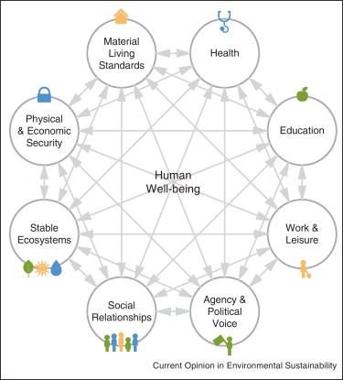
PROBLEM STATEMENT
Many individuals face challenges in maintaining consistent health habits due to a lack of personalized,real-time guidance. Traditional health support is often inaccessible or stigmatized, and available solutionslack emotional intelligence or holistic integration.

Slide 4
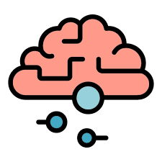
Objective
To develop an Al-powered application that monitors user habits and provides real-time, personalizedsuggestions for healthier living, supporting both physical and mental wellness.
Reduce Maternal and Child Mortality
Combat Communicable Diseases
Ensure Access to Healthcare Services
Improve Road Safety

Slide 5
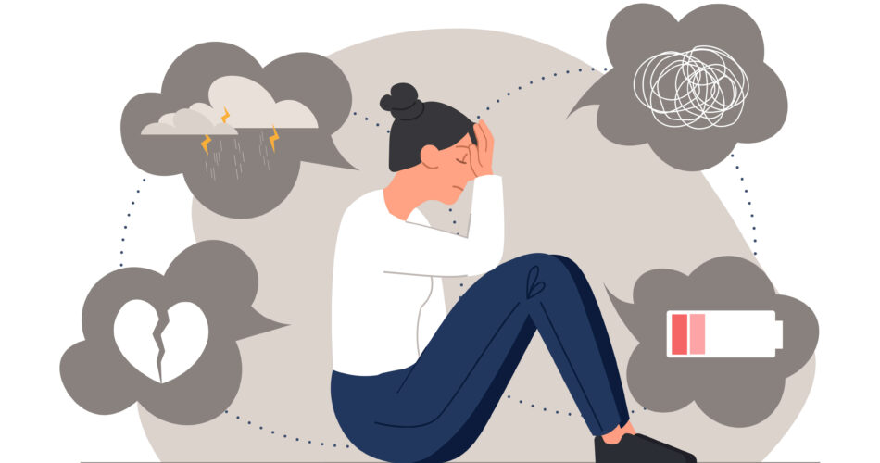
Why This Problem?
The increasing burden of chronic health conditions and mental health issues highlights the urgent need foraccessible, personalized wellness tools. By providing a conversational and adaptive Al solution, users canmake consistent lifestyle improvements backed by data and emotional intelligence.
Lack of Access to Healthcare
Poverty and Inequality
Shortage of Medical Professionals

Slide 6
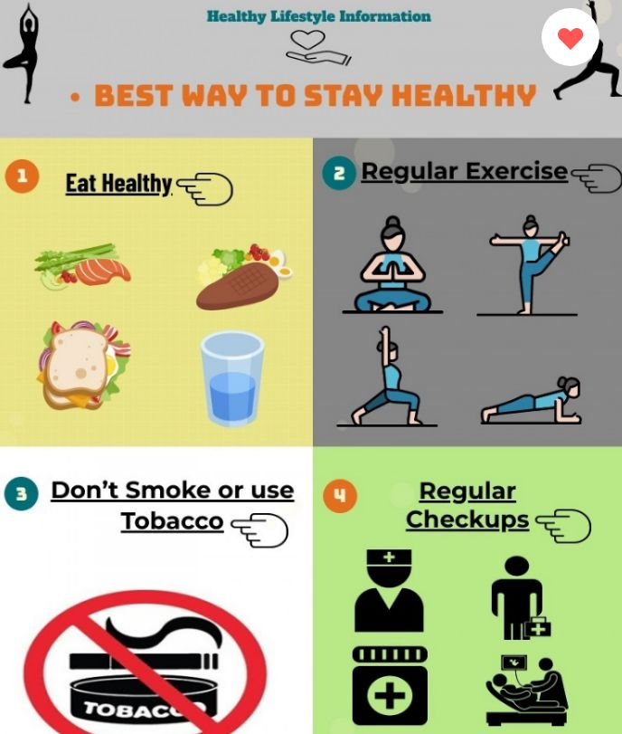
Solution:
- An Al agent that tracks habits and provides real-time suggestions.
- Conversational interface for daily check-ins and motivation.
- Integration with wearables and health data.
- Mood and stress detection via voice or text.
- Empathetic, data-driven insights and recommendations.

Slide 7

Technical Implementation
AI/NLP Training: Used Python in Google Colab for emotion and intent detection models.
Emotion Analysis: Implemented basic keyword and rule-based sentiment analysis without
external libraries like Transformers or spaCy.
User Input Methods: Manual logging and integration with Google Fit using API keys for
data access.
Advisory Logic: Personalized recommendations based on analyzed health behavior
patterns.
Architecture: Lightweight, mobile-first application supported by adaptive backend logic.

Slide 8

Tools And Resources Used:
-Google Colab – For prototyping and model development
- Python – Core programming language
- APIs – Google Fit API with API key-based access for collecting health metrics

Slide 9
Link to GoogleColab:
Direct Link:
https://colab.research.google.com/drive/1PdbIBnHJwu4vqXvrPbvU32VE3TBCH1I8?usp=sharing

Slide 10
Conclusion
Summary:
This Al-powered health coach application provides a holistic, personalized, and scalable wellness tool. It empowers users to make better decisions regarding their physical and mental health. By leveraging Al, it offers a proactive, non-intrusive, and intelligent approach to health management.
Future Work:
Continuous updates and validation with new data.
Addressing any emerging ethical and practical challenges.

